Slide 1
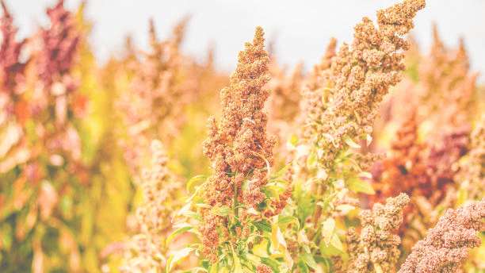
VI International Congress la ValSe Food
Promoting Biodiversity, Sustainability, and Food Security Through Ancestral Ibero-American Crops

Slide 2
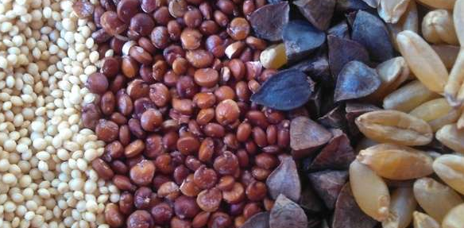
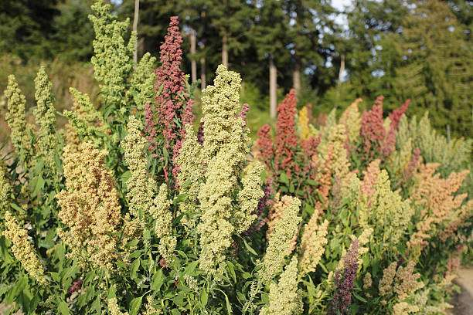
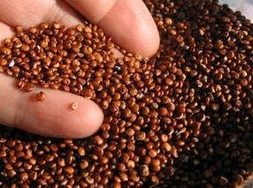
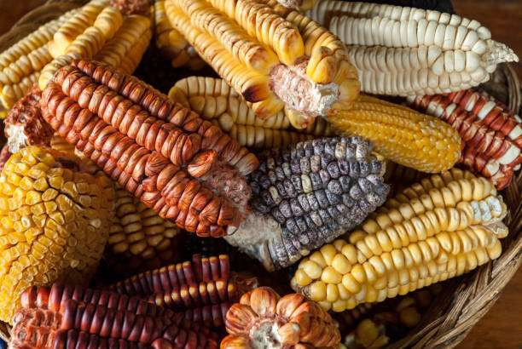
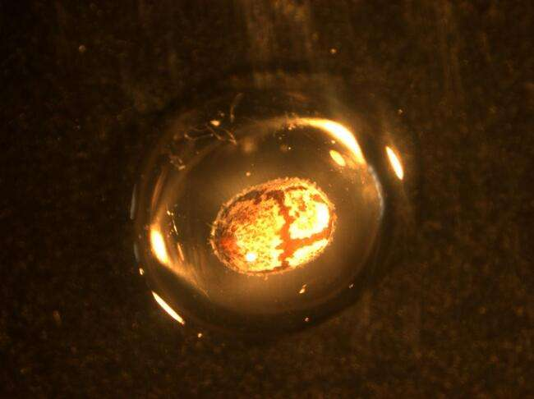
Title
institutional logo
Name
Affiliation

Slide 3
Instructions
Congress Title
Title of the presentation + name and surname + affiliation (1 slide) + institutional logo
Content of the presentation (The number of slides should be adjusted to the time allotted)
Acknowledgements
Duration of the presentations 30 min (25 min + 5 min for questions).
The official spoken language is English, Spanish or Portuguese
and the official written language is English

Slide 4
Text – Tables – Figures – Graphics
Premium
Estándar
Básico
Modalidad 1
Text in English

Slide 5
Acknowledgements

Slide 6
THANK YOU

